Slide 1


Cloud Native Workshop Code Analysis
IBM Hybrid Cloud Ecosystem
Ecosystem Labs

Slide 2

Code Analysis
Static Code Analysis
Dynamic Code Analysis
A key enabler for Continuous Delivery is automated validation of the application components. Code analysis provides a layer of the automated validation.
Notes:
Static Code Analysis: A method of debugging by performing automated evaluation of code without executing the program. The analysis is structured as a set of coding rules that evaluate the code’s quality.
Dynamic Code Analysis: Dynamic analysis observes a running program. Dynamic analysis requires test inputs and can measure user functionality as well as runtime qualities like execution time and resource consumption.

Slide 3
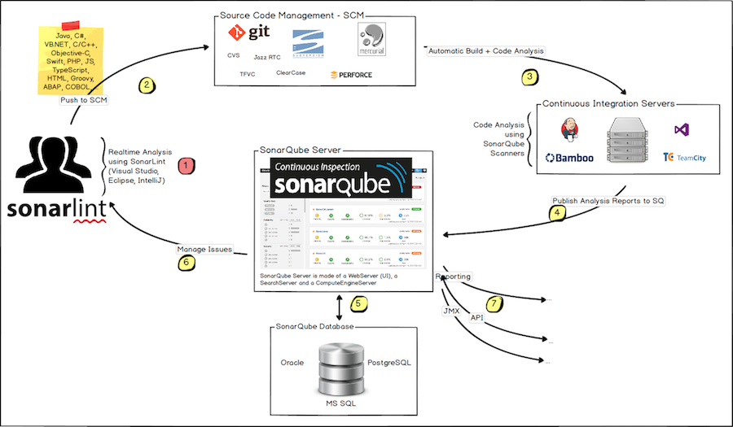
SonarQube
Open source tool built by SonarSource.
Strong community of 120K users
Support for 27 programming languages
Plugs into the application lifecycle management process to make continuous inspection part of continuous integration.
Notes:
The SonarQube solution consists of several components:
SonarScanner: The brain of SonarQube.It processes the resulting analysis reports.
SonarQube UI: It displays the reports.
SonarQube Database: The reports are stored here.
SonarQube Server: The central component which runs the SonarScanner, stores the reports in SonarQube Database, and displays the reports in the SonarQube UI.
Workflow:
Developers code in their IDEs and use SonarLint to run local analysis.
Developers push their code into their favourite SCM : git, SVN, TFVC, ...
The Continuous Integration Server triggers an automatic build, and the execution of the SonarScanner required to run the SonarQube analysis.
The analysis report is sent to the SonarQube Server for processing.
SonarQube Server processes and stores the analysis report results in the SonarQube Database, and displays the results in the UI.
Developers review, comment, challenge their Issues to manage and reduce their Technical Debt through the SonarQube UI.
Managers receive Reports from the analysis. Ops use APIs to automate configuration and extract data from SonarQube. Ops use JMX to monitor SonarQube Server.

Slide 4
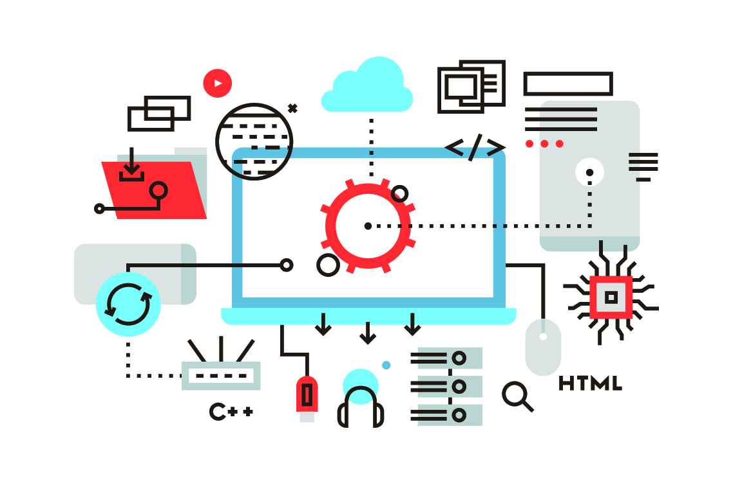
Focus Areas
Code Reliability: Detect bugs that will impact end-user functionality.
Application Security: Detect vulnerabilities and hotspots that can be exploited to compromise the program
Technical Debt: Keep your codebase maintainable to increase developer velocity.

